Slide 1
Data Modeling
Unit - II

Slide 2
Data modeling (data modeling) is the process of creating a data model for the data to be stored in a database.
This data model is a conceptual representation of Data objects, the associations between different data objects, and the rules.
Data modeling helps in the visual representation of data and enforces business rules, regulatory compliances, and government policies on the data.
Data Models ensure consistency in naming conventions, default values, semantics, security while ensuring quality of the data.

Slide 3
Data Model
TheData Model is defined as an abstract model that organizes data description, data semantics, and consistency constraints of data.
The data model emphasizes on what data is needed and how it should be organized instead of what operations will be performed on data.
Data Model is like an architect's building plan, which helps to build conceptual models and set a relationship between data items.

Slide 4
The two types of Data Modeling Techniques are:
Entity Relationship (E-R) Model
UML (Unified Modelling Language)

Slide 5
The primary goal of using data model are:
Ensures that all data objects required by the database are accurately represented. Omission of data will lead to creation of faulty reports and produce incorrect results.
A data model helps design the database at the conceptual, physical and logical levels.
Data Model structure helps to define the relational tables, primary and foreign keys and stored procedures.
It provides a clear picture of the base data and can be used by database developers to create a physical database.
It is also helpful to identify missing and redundant data.
Though the initial creation of data model is labor and time consuming, in the long run, it makes your IT infrastructure upgrade and maintenance cheaper and faster.

Slide 6
Types of Data Models
Conceptual Data Model: This Data Model defines WHAT the system contains. This model is typically created by Business stakeholders and Data Architects. The purpose is to organize, scope and define business concepts and rules.
Logical Data Model: Defines HOW the system should be implemented regardless of the DBMS. This model is typically created by Data Architects and Business Analysts. The purpose is to developed technical map of rules and data structures.
Physical Data Model: This Data Model describes HOW the system will be implemented using a specific DBMS system. This model is typically created by DBA and developers. The purpose is actual implementation of the database.

Slide 7
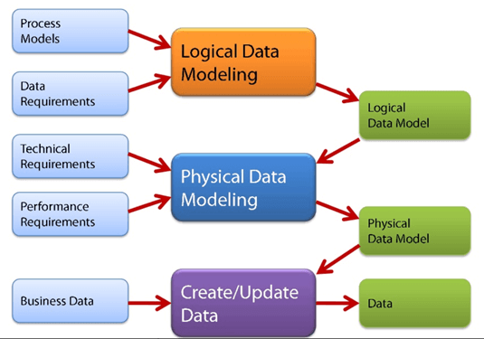

Slide 8
Conceptual Data Model
A Conceptual Data Model is an organized view of database concepts and their relationships. The purpose of creating a conceptual data model is to establish entities, their attributes, and relationships. In this data modeling level, there is hardly any detail available on the actual database structure. Business stakeholders and data architects typically create a conceptual data model.
The 3 basic tenants of Conceptual Data Model are
Entity: A real-world thing
Attribute: Characteristics or properties of an entity
Relationship: Dependency or association between two entities
Data model example:
Customer and Product are two entities. Customer number and name are attributes of the Customer entity
Product name and price are attributes of product entity
Sale is the relationship between the customer and product

Slide 9
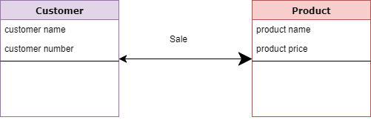

Slide 10
Characteristics of a conceptual data model :
Offers Organization-wide coverage of the business concepts.
This type of Data Models are designed and developed for a business audience.
The conceptual model is developed independently of hardware specifications like data storage capacity, location or software specifications like DBMS vendor and technology. The focus is to represent data as a user will see it in the "real world."

Slide 11
Logical Data Model
The Logical Data Model is used to define the structure of data elements and to set relationships between them.
The logical data model adds further information to the conceptual data model elements.
The advantage of using a Logical data model is to provide a foundation to form the base for the Physical model.
However, the modeling structure remains generic.

Slide 12
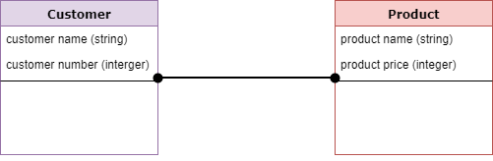
At this Data Modeling level, no primary or secondary key is
defined. At this Data modeling level, you need to verify and
adjust the connector details that were set earlier for
relationships.

Slide 13
Characteristics of a Logical data model
Describes data needs for a single project but could integrate with other logical data models based on the scope of the project.
Designed and developed independently from the DBMS.
Data attributes will have datatypes with exact precisions and length.
Normalization processes to the model is applied typically till 3NF.

Slide 14
Physical Data Model
A Physical Data Model describes a database-specific implementation of the data model.
It offers database abstraction and helps generate the schema.
This is because of the richness of meta-data offered by a Physical Data Model. The physical data model also helps in visualizing database structure by replicating database column keys, constraints, indexes, triggers, and other RDBMS features.

Slide 15
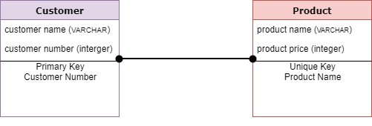

Slide 16
Characteristics of a physical data model:
The physical data model describes data need for a single project or application though it maybe integrated with other physical data models based on project scope.
Data Model contains relationships between tables that which addresses cardinality and nullability of the relationships.
Developed for a specific version of a DBMS, location, data storage or technology to be used in the project.
Columns should have exact datatypes, lengths assigned and default values.
Primary and Foreign keys, views, indexes, access profiles, and authorizations, etc. are defined.

Slide 17
Advantages of Data model:
The main goal of a designing data model is to make certain that data objects offered by the functional team are represented accurately.
The data model should be detailed enough to be used for building the physical database.
The information in the data model can be used for defining the relationship between tables, primary and foreign keys, and stored procedures.
Data Model helps business to communicate the within and across organizations.
Help to recognize correct sources of data to populate the model

Slide 18
Disadvantages of Data model:
To develop Data model one should know physical data stored characteristics.
This is a navigational system produces complex application development, management. Thus, it requires a knowledge of the biographical truth.
Even smaller change made in structure require modification in the entire application.
There is no set data manipulation language in DBMS.

